Slide 1
Secure data hiding in image using steganography
CAPSTONE PROJECT
Presented By: Akanksha Jha
College Name & Department : RDS COLLEGE MUZAFFARPUR
BCA Department

Slide 2
OUTLINE
Problem Statement
Technology used
Wow factor
End users
Result
Conclusion
Git-hub Link
Future scope

Slide 3
Problem Statement
With increasing digital communication, securing sensitive information is crucial. Traditional encryption methods are often detectable, making them vulnerable to attacks. This project explores steganography, a technique for concealing data within images, audio, or text, ensuring covert communication. The goal is to develop an efficient and robust steganographic system that enhances security while maintaining data integrity and minimal perceptual distortion.

Slide 4
Technology used
This steganography project is developed using Python and leverages OpenCV (`cv2`) for image processing. It employs pixel manipulation and RGB channel encoding to embed a secret message within an image while ensuring minimal distortion. The OS module is used for file handling, including passcode storage in a text file. A basic authentication mechanism ensures that only users with the correct passcode can decrypt the hidden message. This project can be further enhanced with encryption, a graphical user interface (GUI), or web-based implementation.

Slide 5
Wow factors
This project stands out due to the following unique features:
Pixel-Level Steganography – The message is embedded directly within pixel values, ensuring minimal distortion.
RGB Channel Encoding – Utilizes all three color channels for efficient data storage.
Passcode Protection – Adds an authentication layer to prevent unauthorized access.
Compression-Free Image Handling – Uses PNG format to avoid data loss during storage.
Scalability & Expandability – Can be enhanced with encryption, GUI, or web-based implementation.

Slide 6
End users
The end users of this steganography project can include:
Cybersecurity Professionals – For securely transmitting sensitive information without raising suspicion.
Journalists & Whistleblowers – To conceal confidential messages within images for secure communication.
Government & Intelligence Agencies – For covert communication and data protection.
Researchers & Academics – For studying and implementing advanced data-hiding techniques.
General Users – Individuals who want to privately share messages without detection.
Would you like to tailor the project for a specific user group?

Slide 7
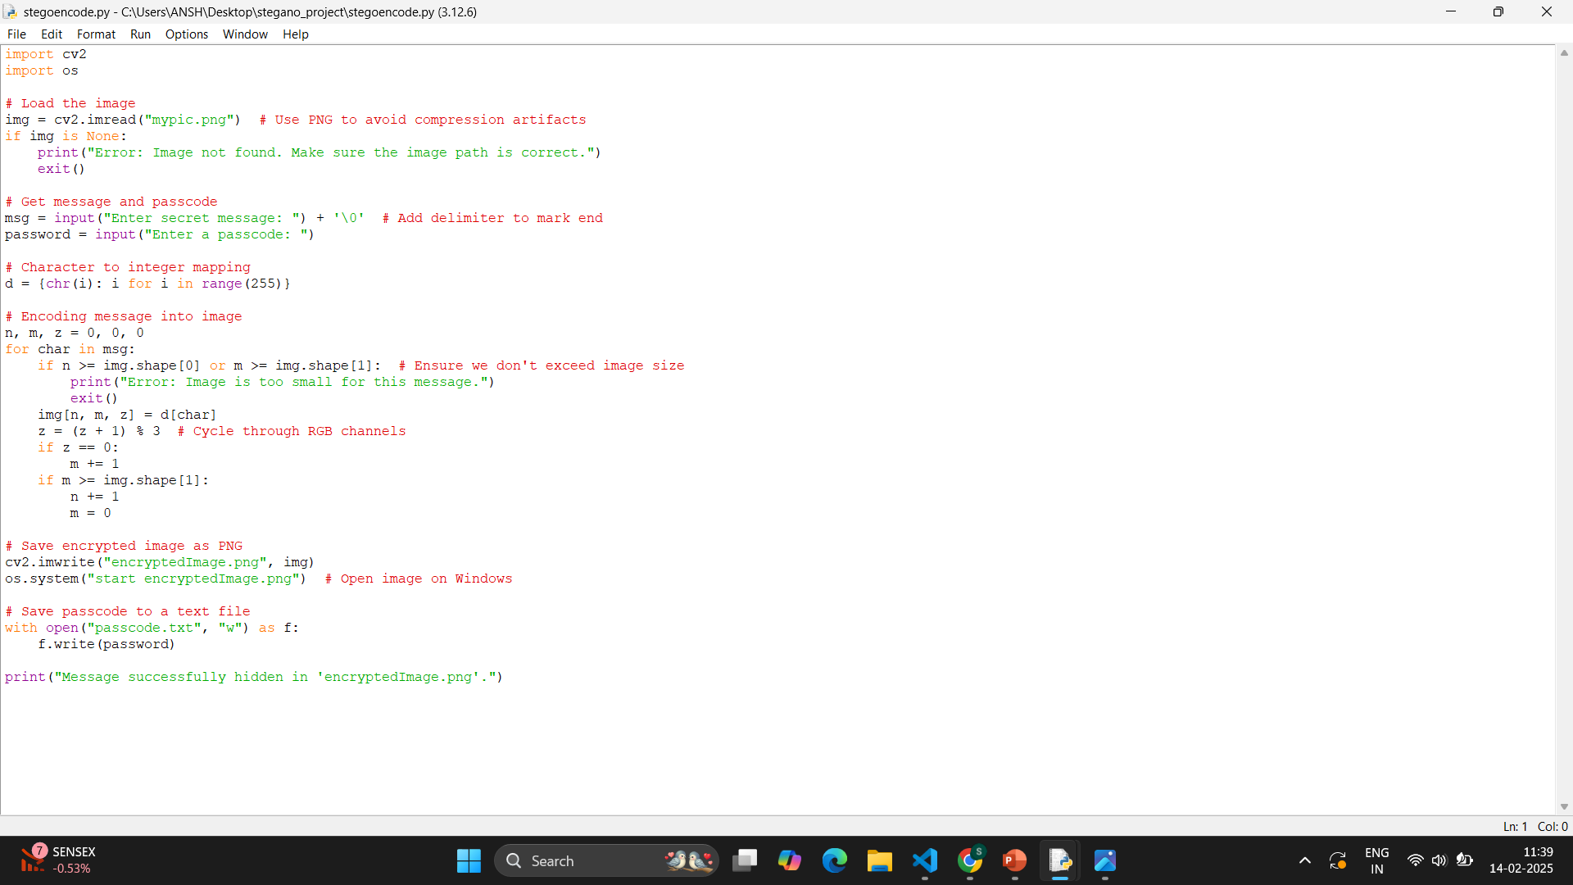
Results

Slide 8
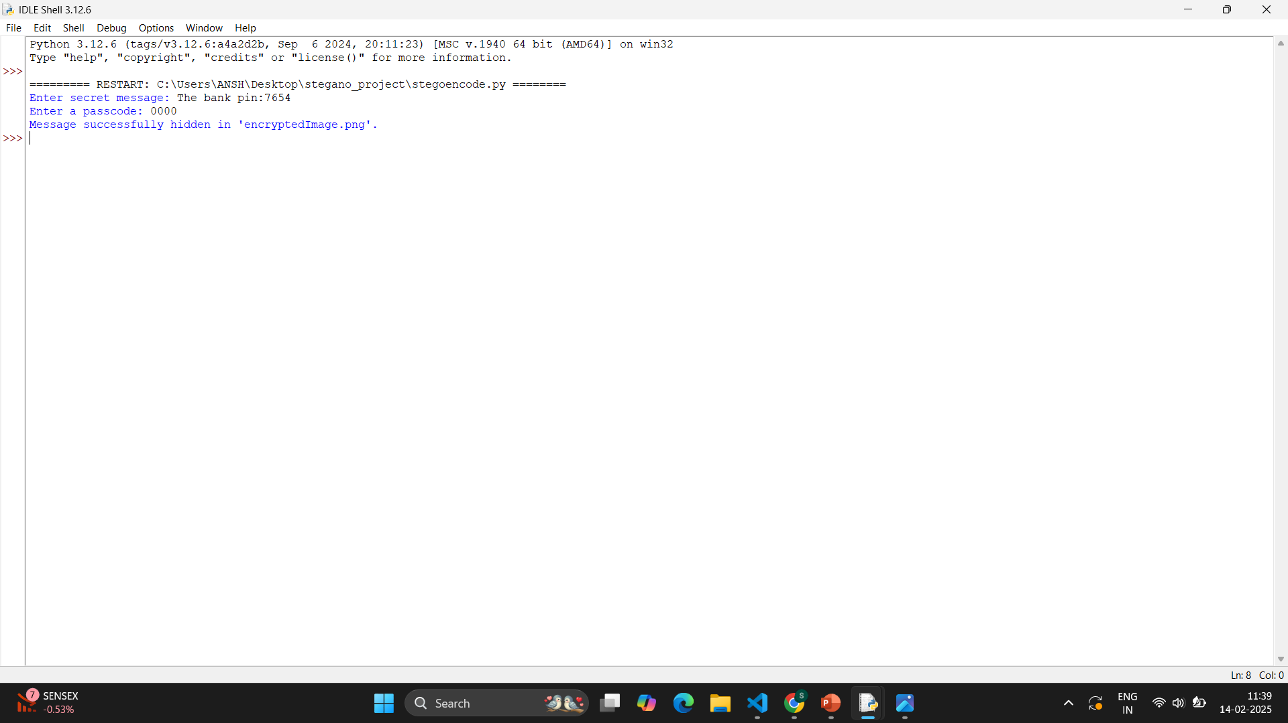
RESULTS

Slide 9
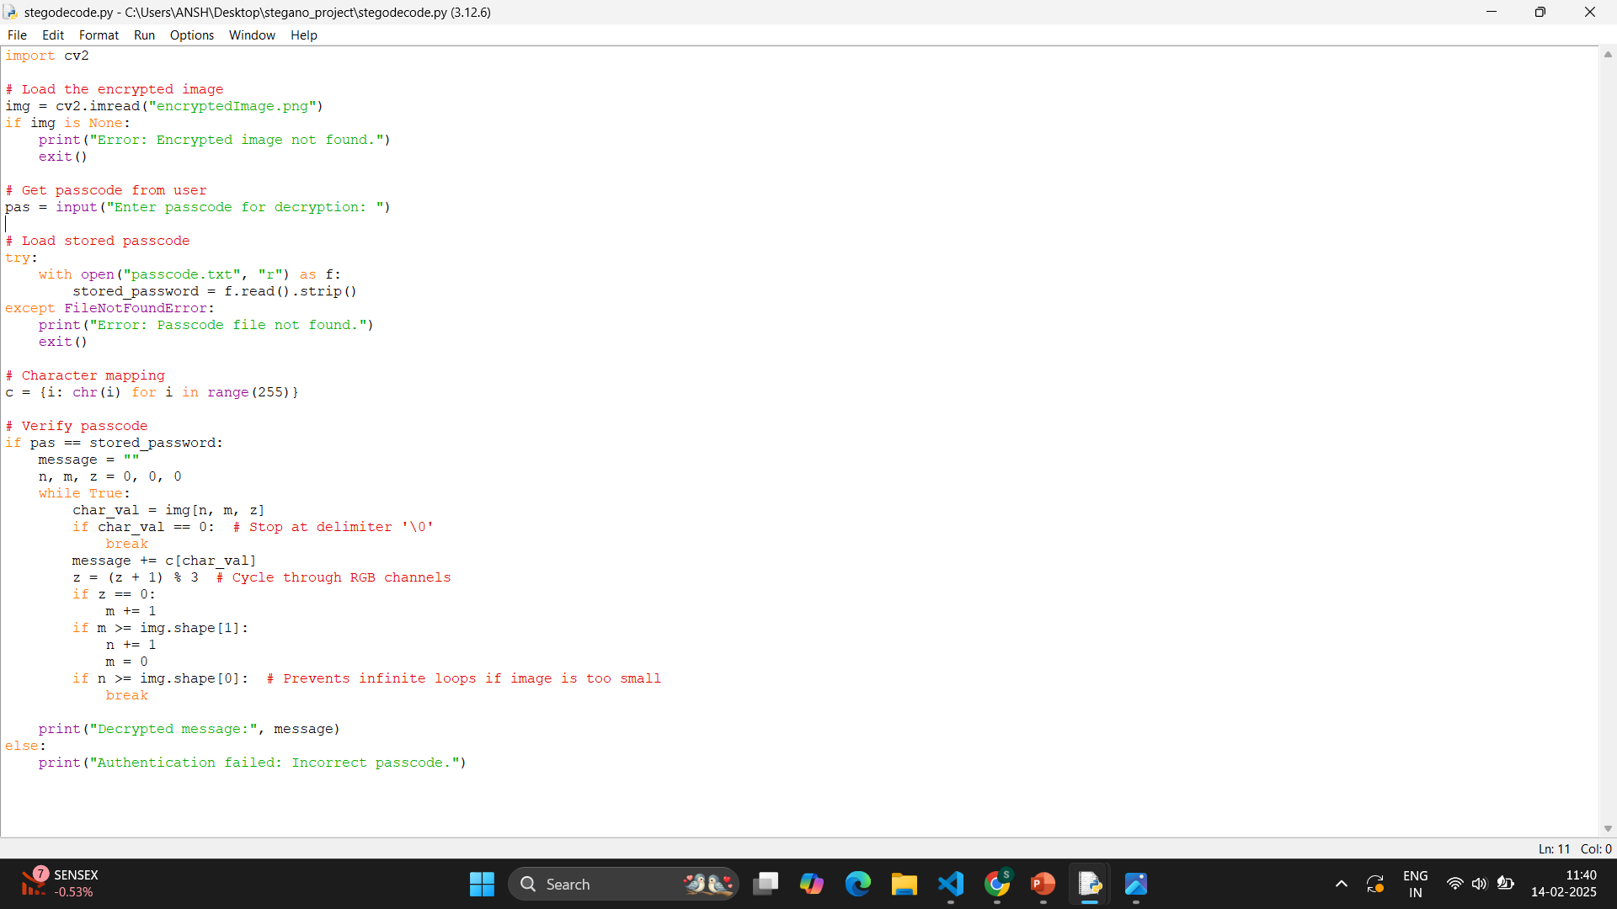
RESULTS

Slide 10
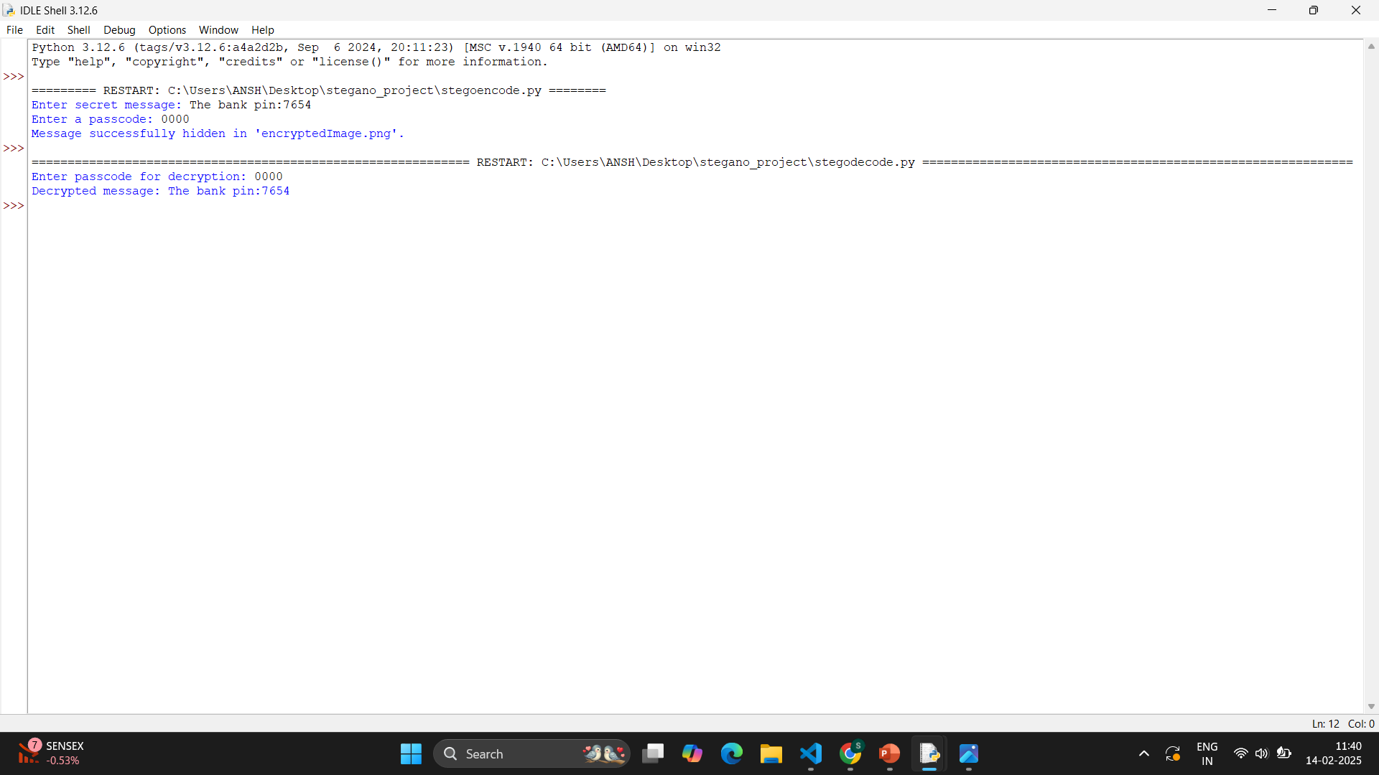
RESULTS

Slide 11
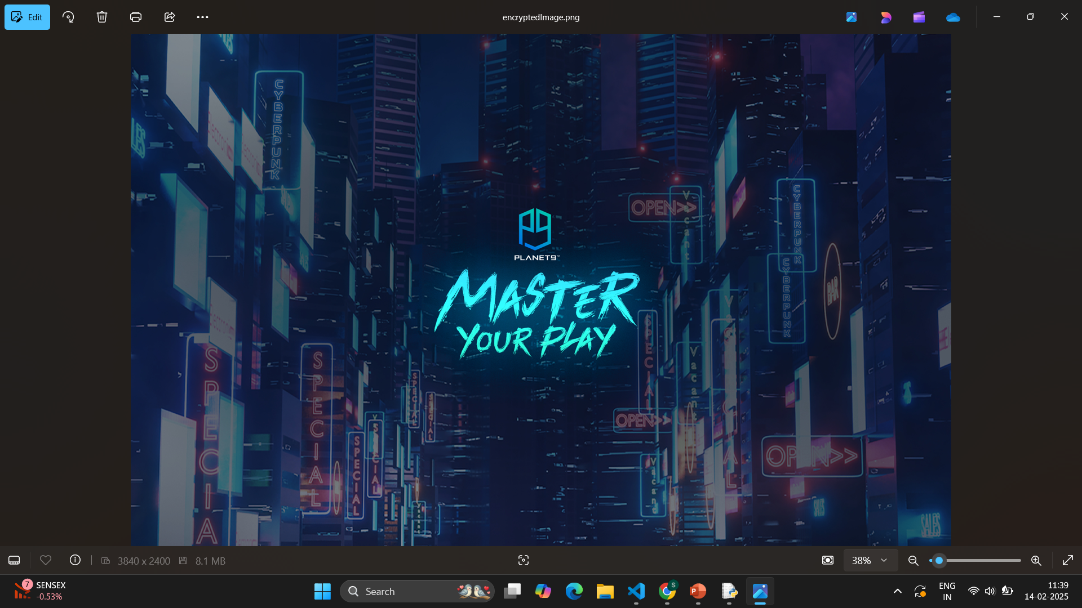
ENCRYPTED IMAGE

Slide 12
Conclusion
The project successfully addresses the problem of secure and covert communication by utilizing steganography to embed hidden messages within images. Through pixel-level manipulation and RGB channel encoding, the system ensures that sensitive data remains concealed from unauthorized access. Additionally, passcode protection enhances security by restricting decryption to authorized users. This solution is effective for cybersecurity applications, secure messaging, and confidential data sharing making it a valuable tool for individuals and organizations seeking privacy in digital communication.

Slide 13
GitHub Link
https://github.com/ItsAkanksha1/AICTE-Steganography_Project.git

Slide 14
Future scope(optional)
1. Enhanced Security with Encryption – Integrate cryptographic algorithms (AES, RSA) to further protect hidden messages before embedding them in images.
2. GUI Integration – Develop a user-friendly interface using Tkinter, PyQt, or a web-based platform for ease of use.
3. Support for Multiple File Formats – Extend compatibility to support various image formats like PNG, BMP, and TIFF to prevent compression loss.
4. Higher Capacity Encoding – Optimize data embedding techniques (e.g., LSB substitution with error correction) to store larger messages efficiently.
5. Automated Detection and Retrieval – Implement AI-powered steganalysis to detect steganographic content and improve security.
6. Cross-Platform Deployment – Expand to mobile (Android/iOS) and web applications for wider accessibility.

Slide 15
THANK YOU

